Slide 1
Determining Retail Categories to Open in the Church Hill Neighborhood of Richmond, VA
Mitch Phillips

Slide 2
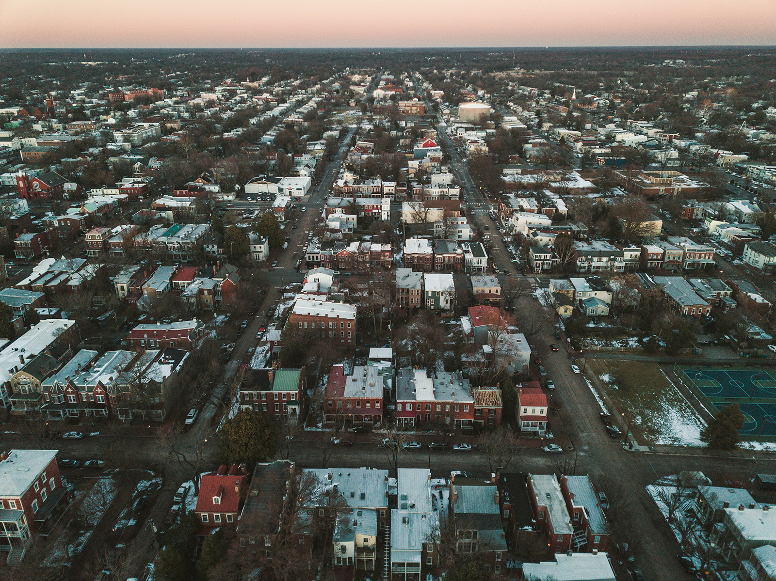
Introduction - Background
ASDFLLA

Slide 3
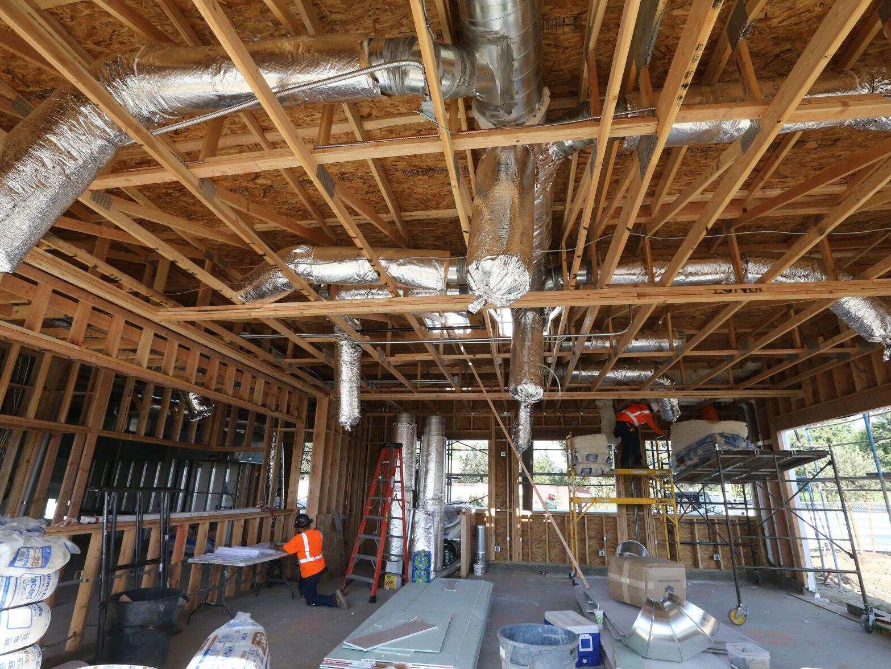
Introduction - Problem
adfjha

Slide 4
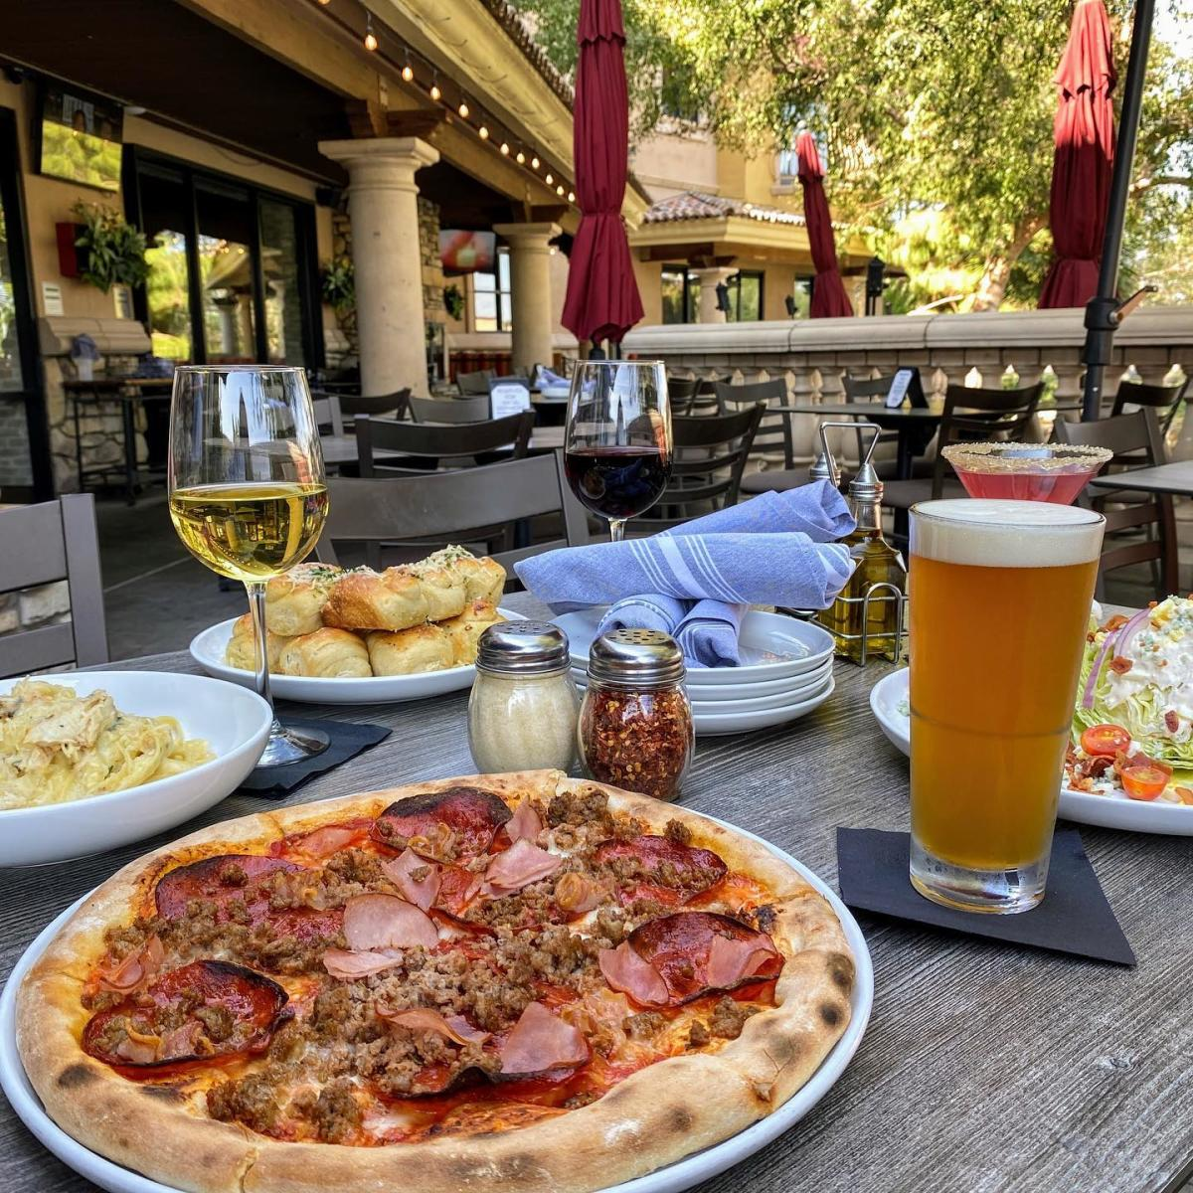
Introduction - Plan
asdfa

Slide 5
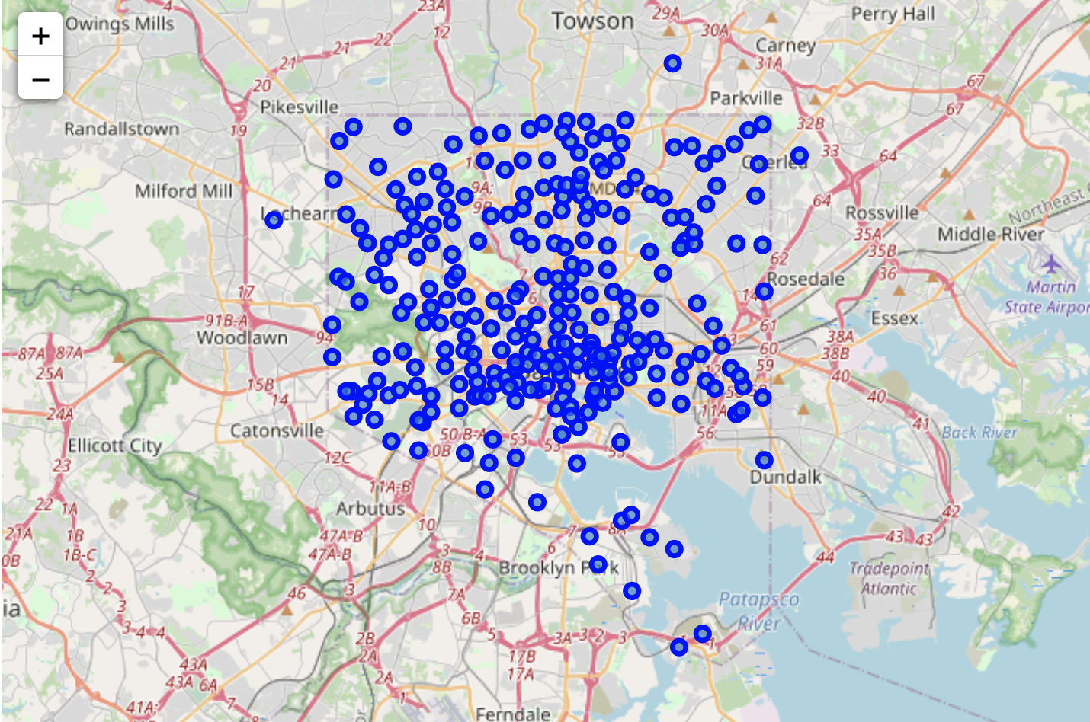
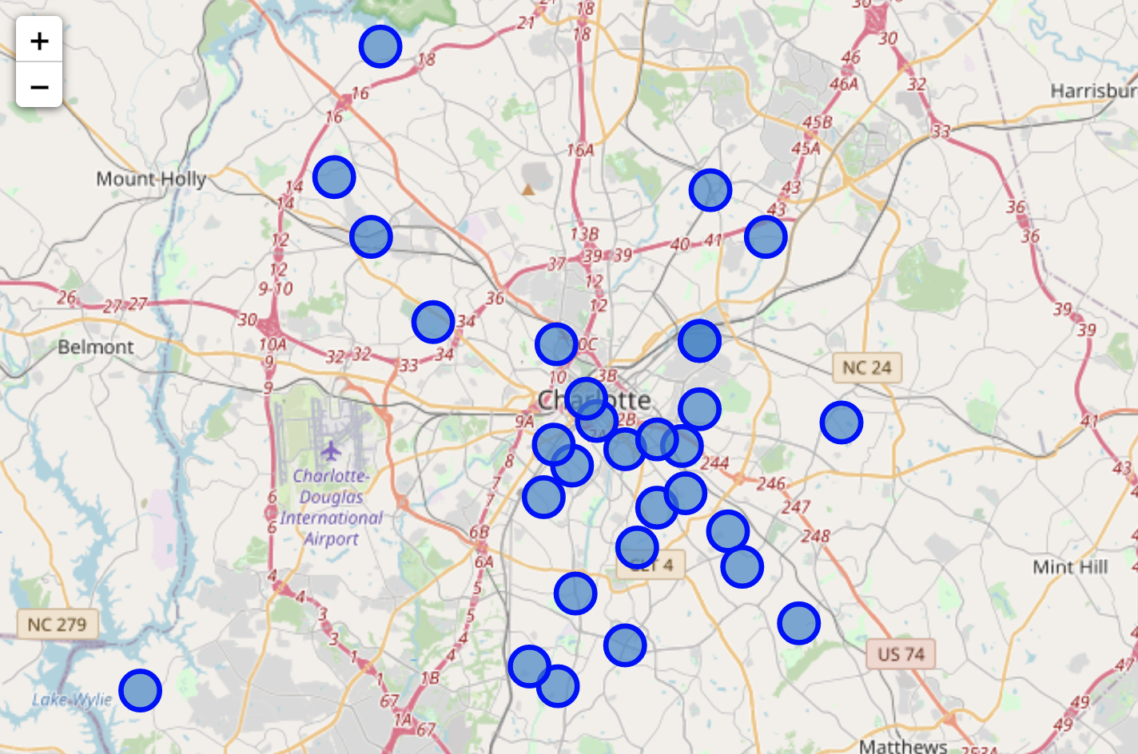
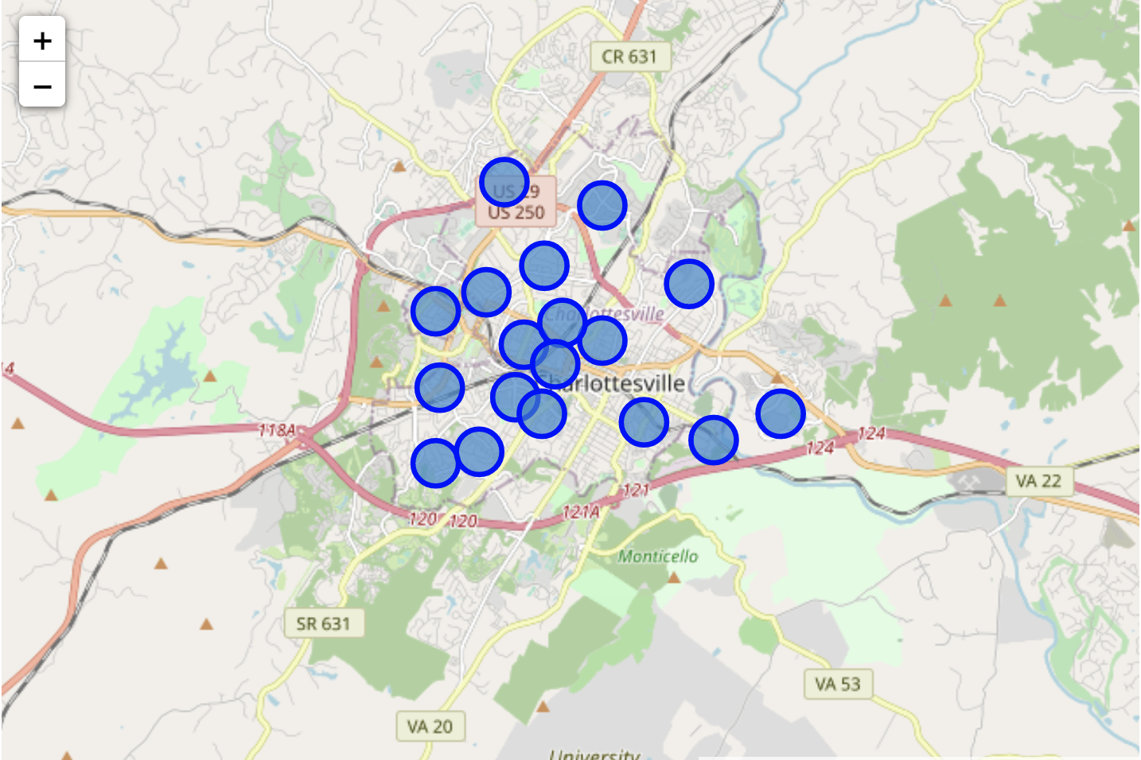
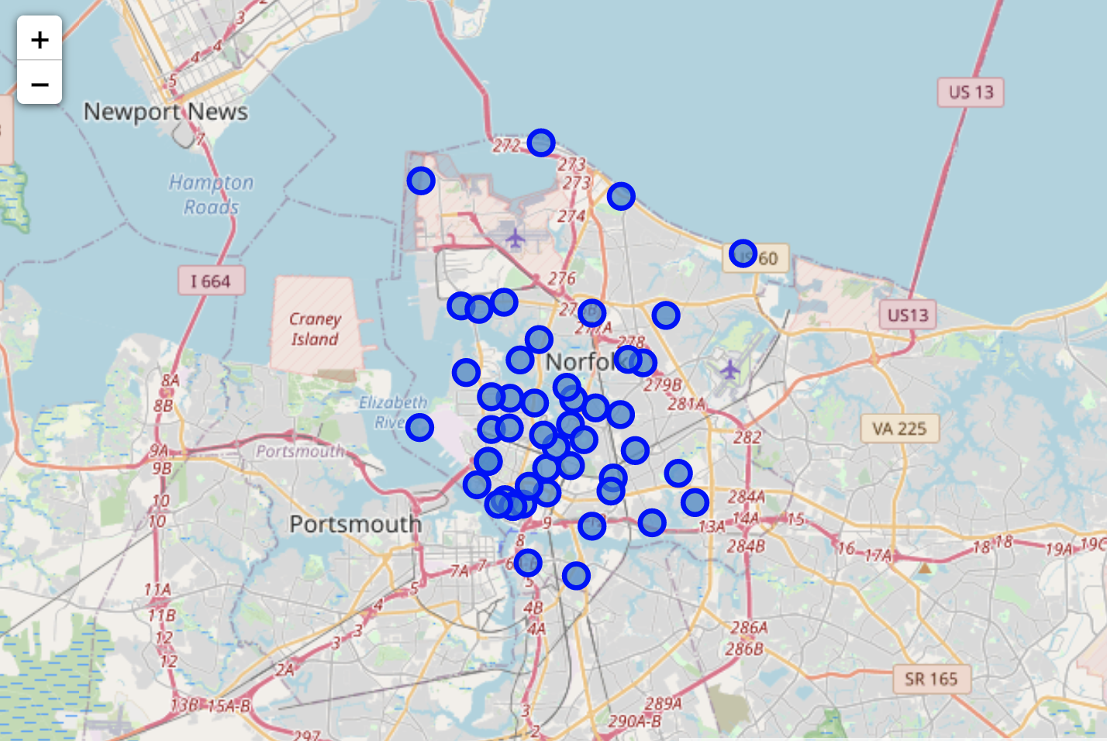
Neighborhood Data Collection

Slide 6
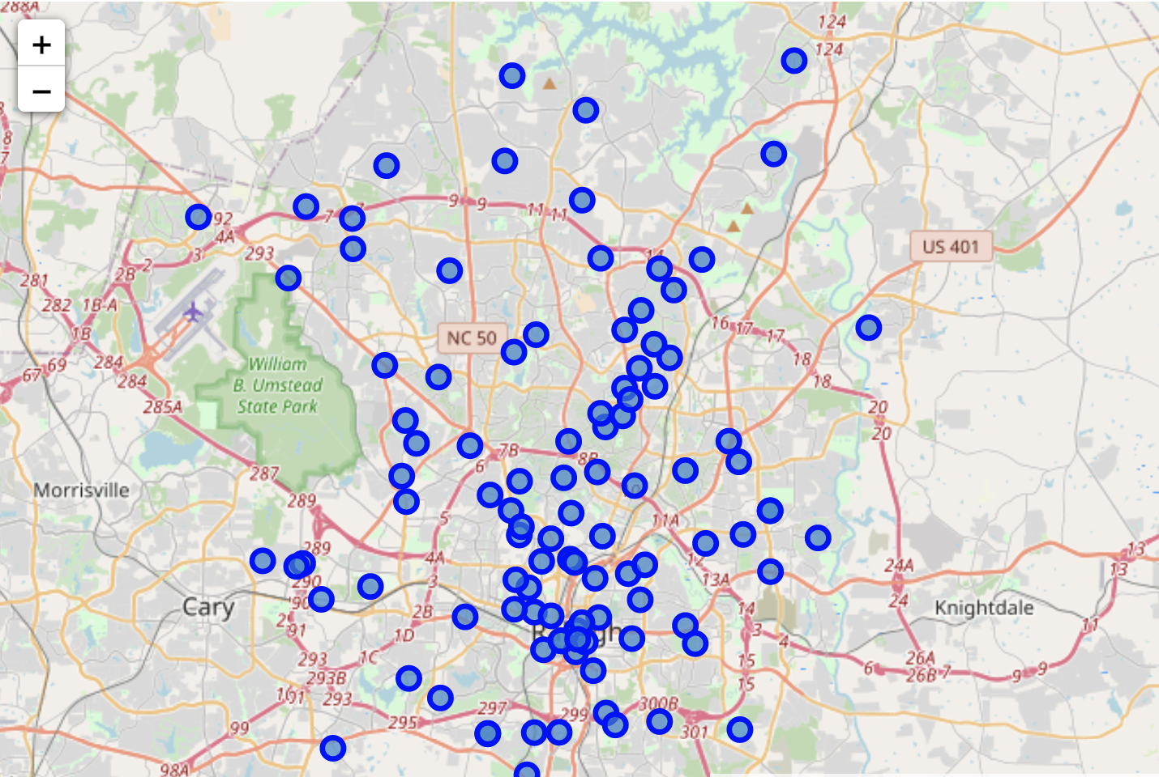
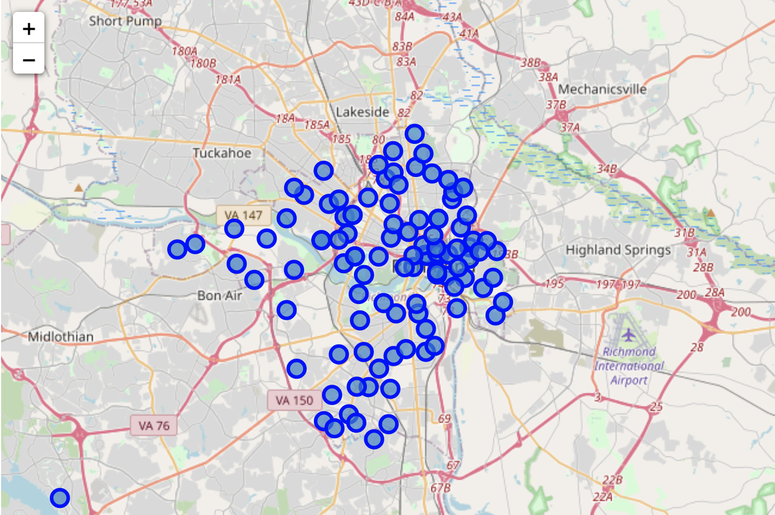
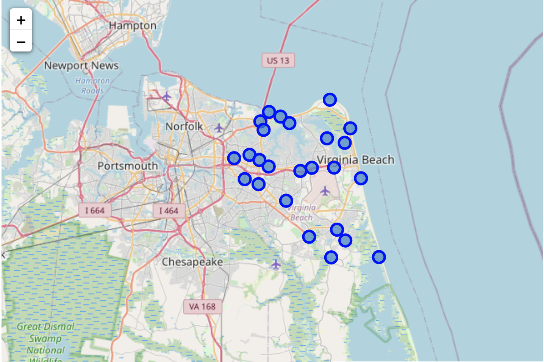
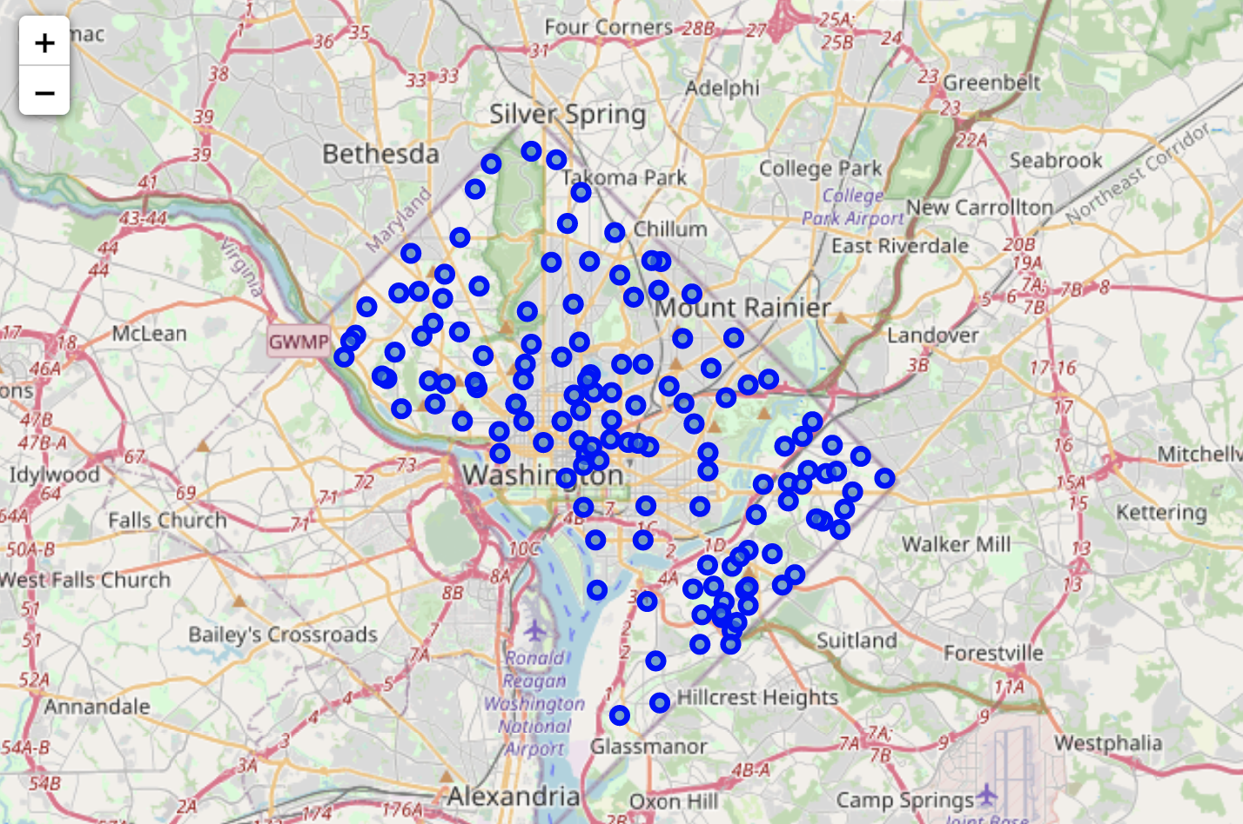
Neighborhood Data Collection

Slide 7
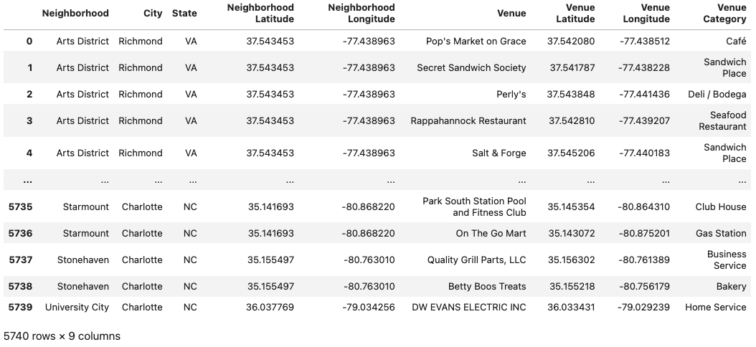
Foursquare Retail Venue Data
adfasdf

Slide 8
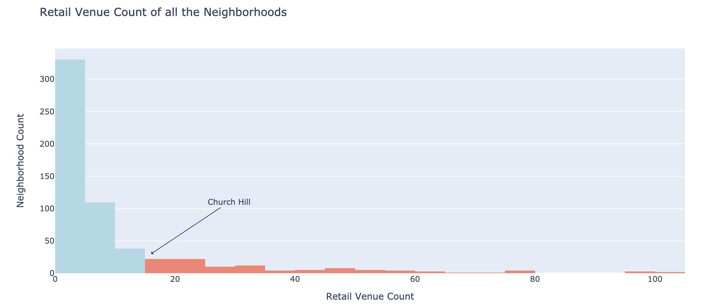
Data Cleaning – Removing Small Neighborhoods
asdfafd

Slide 9
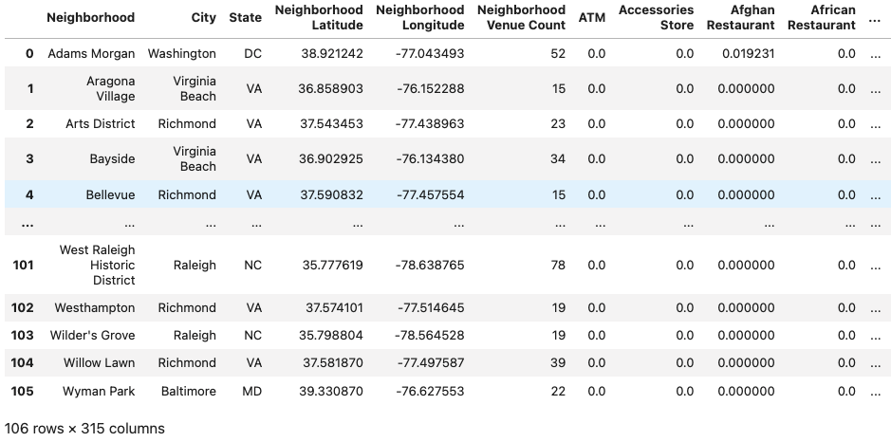
Data Preparation – Category Frequencies
adfasdf

Slide 10
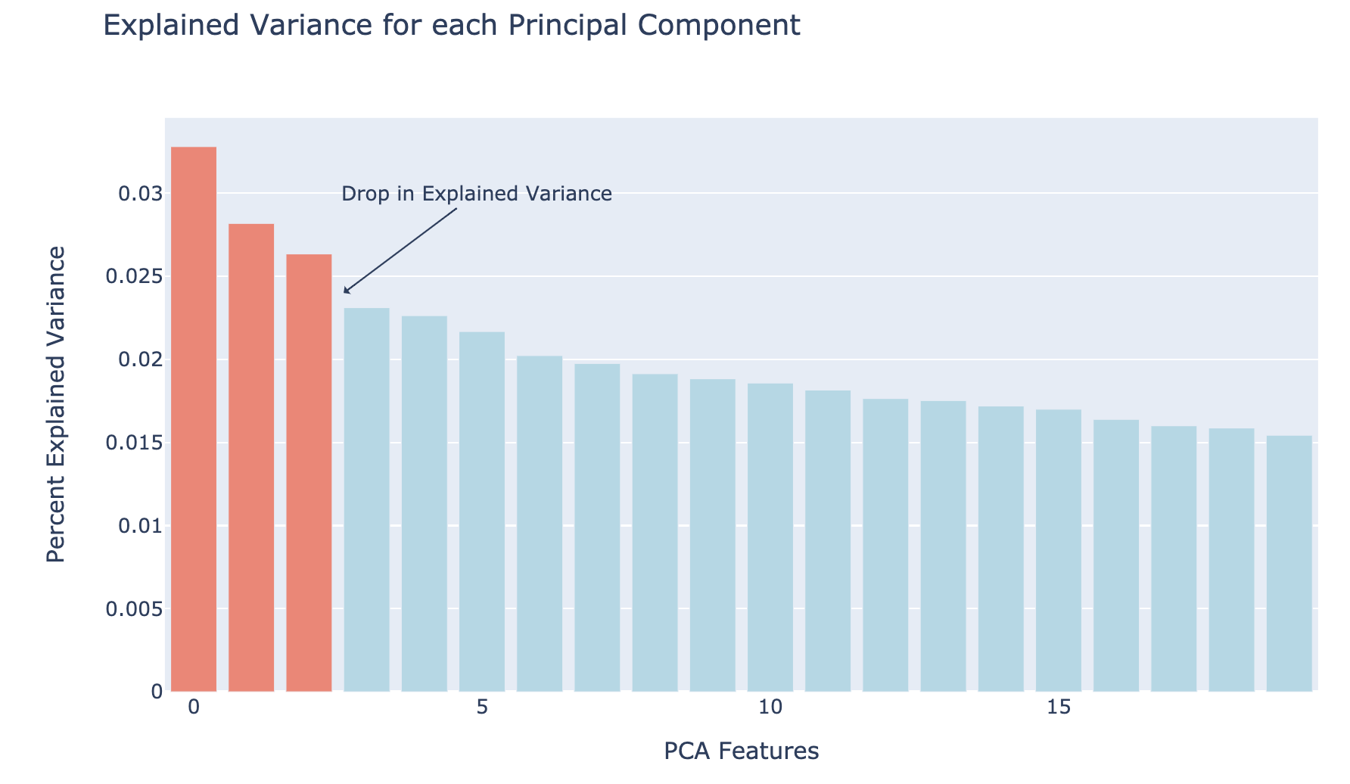
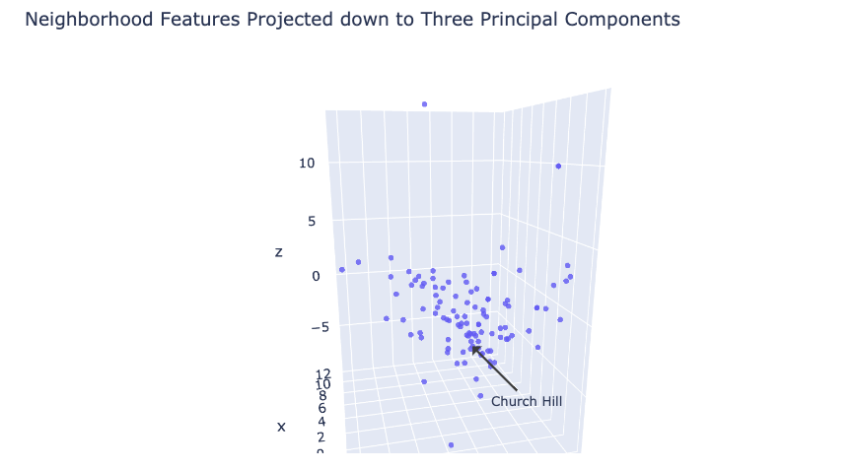
Data Preparation – PCA Dimensionality Reduction
adfasf

Slide 11
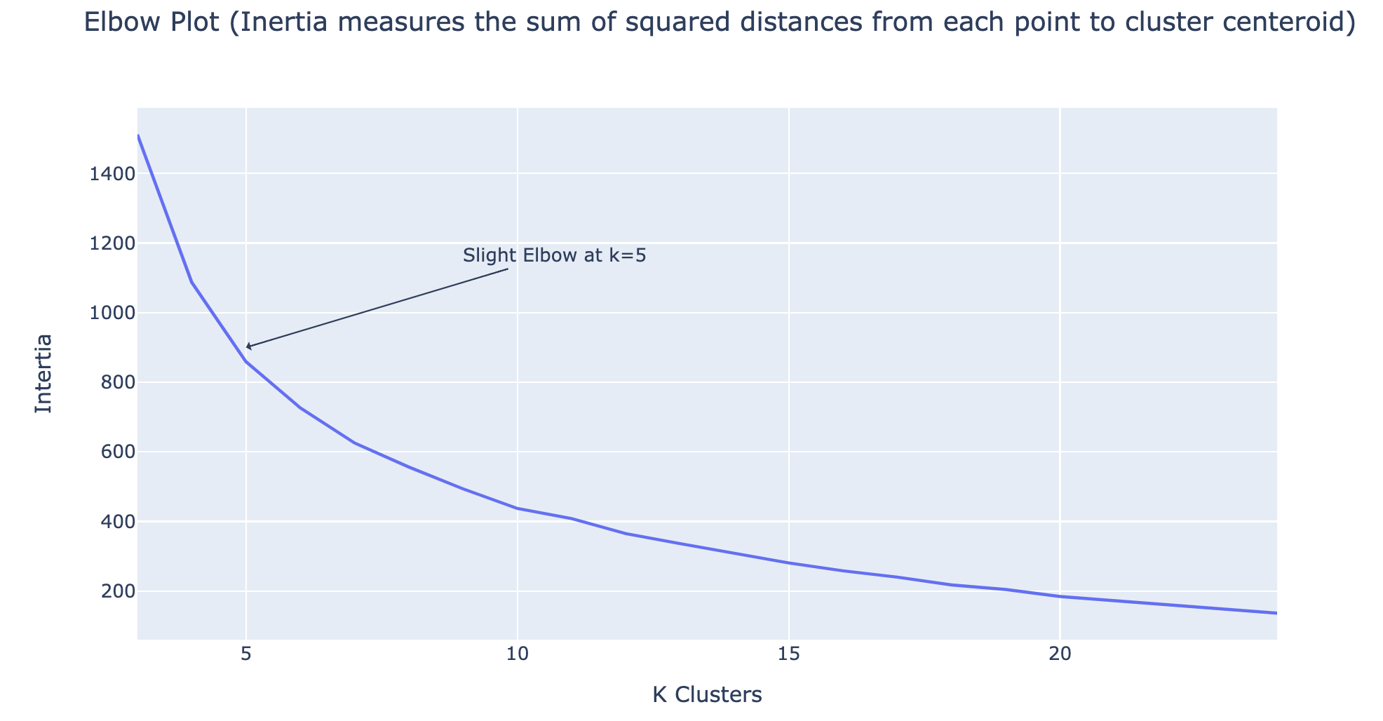
Training the K-Means Model
adsdfas

Slide 12
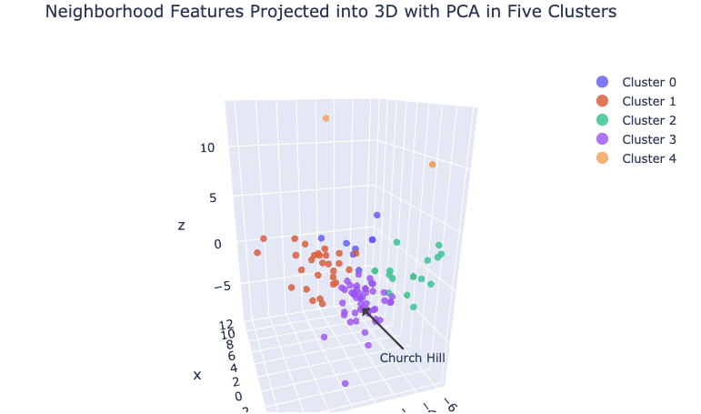
Clustering Results
dfadf

Slide 13
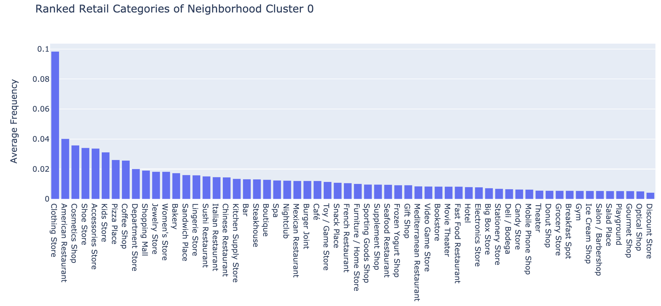
Analysis - Ranked Retail Categories of Cluster 0

Slide 14
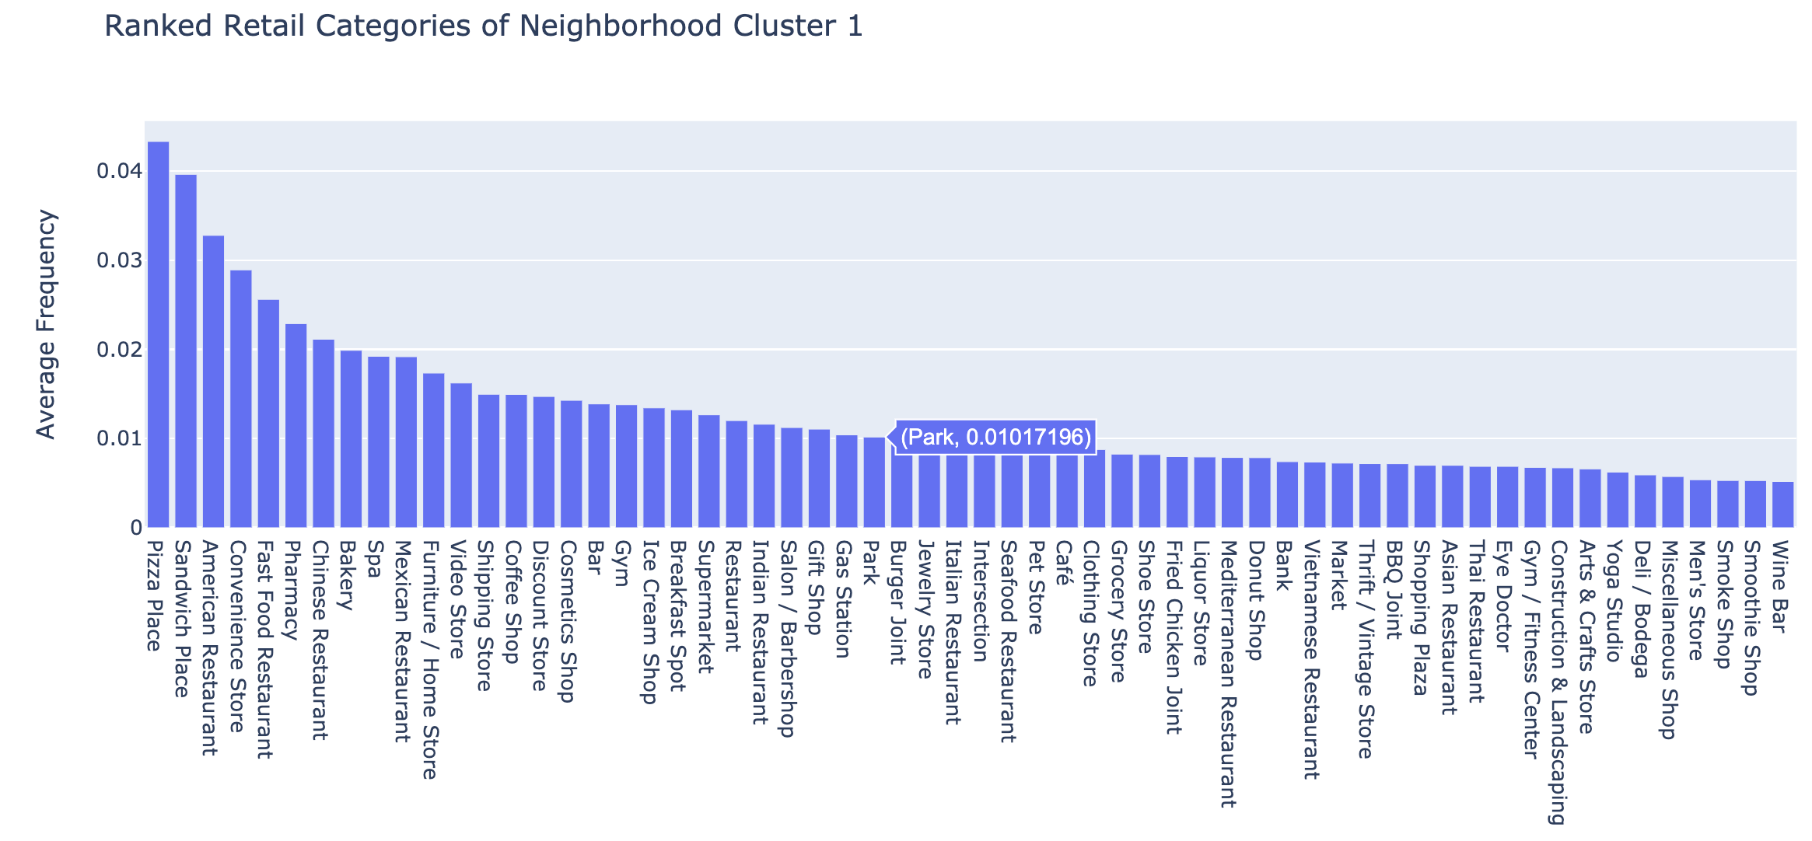
Analysis - Ranked Retail Categories of Cluster 1

Slide 15
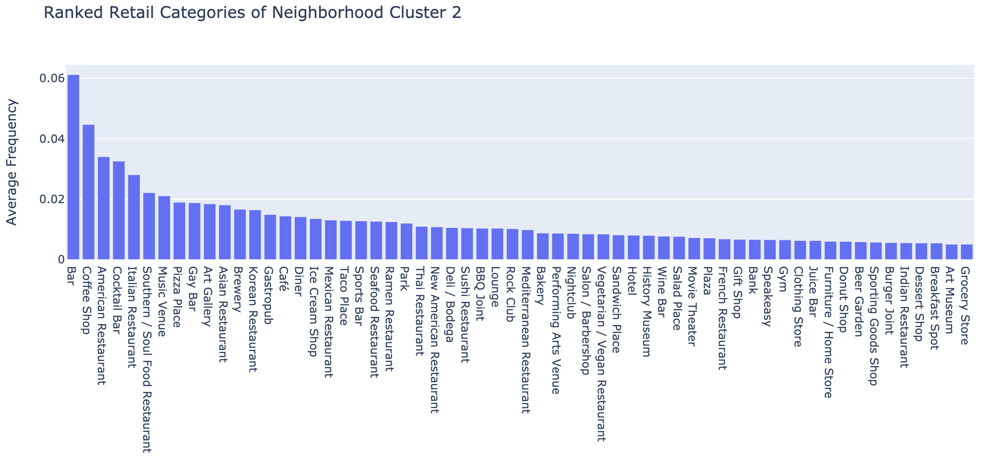
Analysis - Ranked Retail Categories of Cluster 2

Slide 16
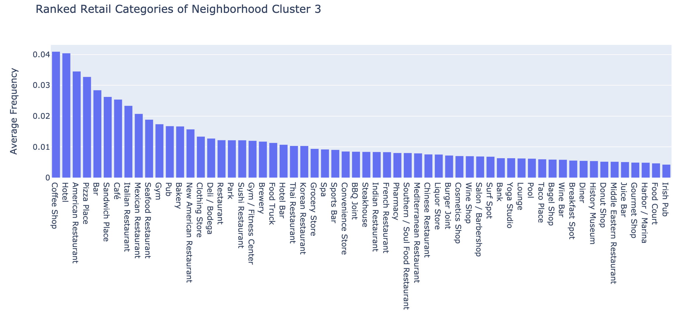
Analysis - Ranked Retail Categories of Cluster 3

Slide 17
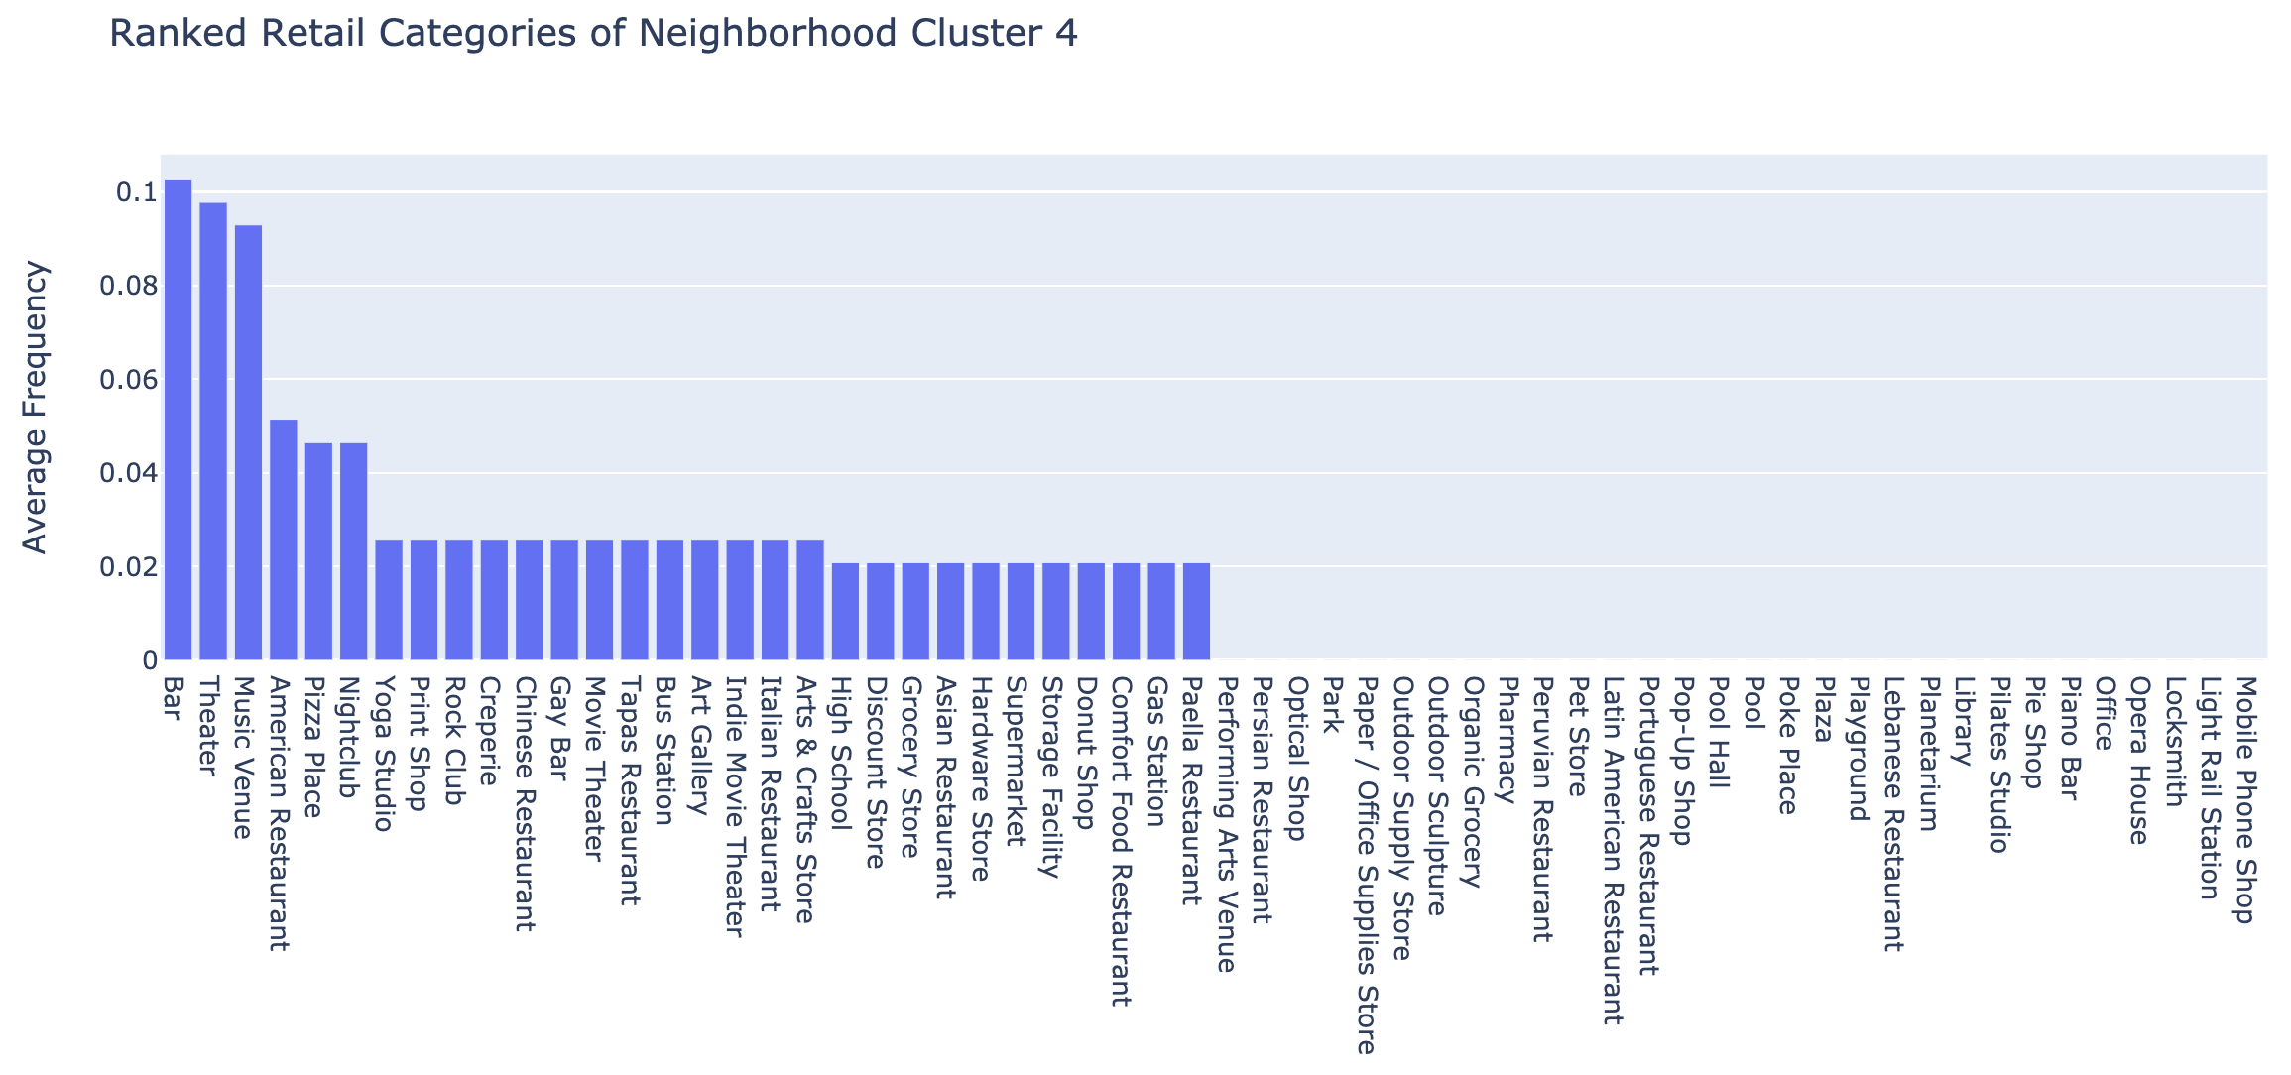
Analysis - Ranked Retail Categories of Cluster 4

Slide 18
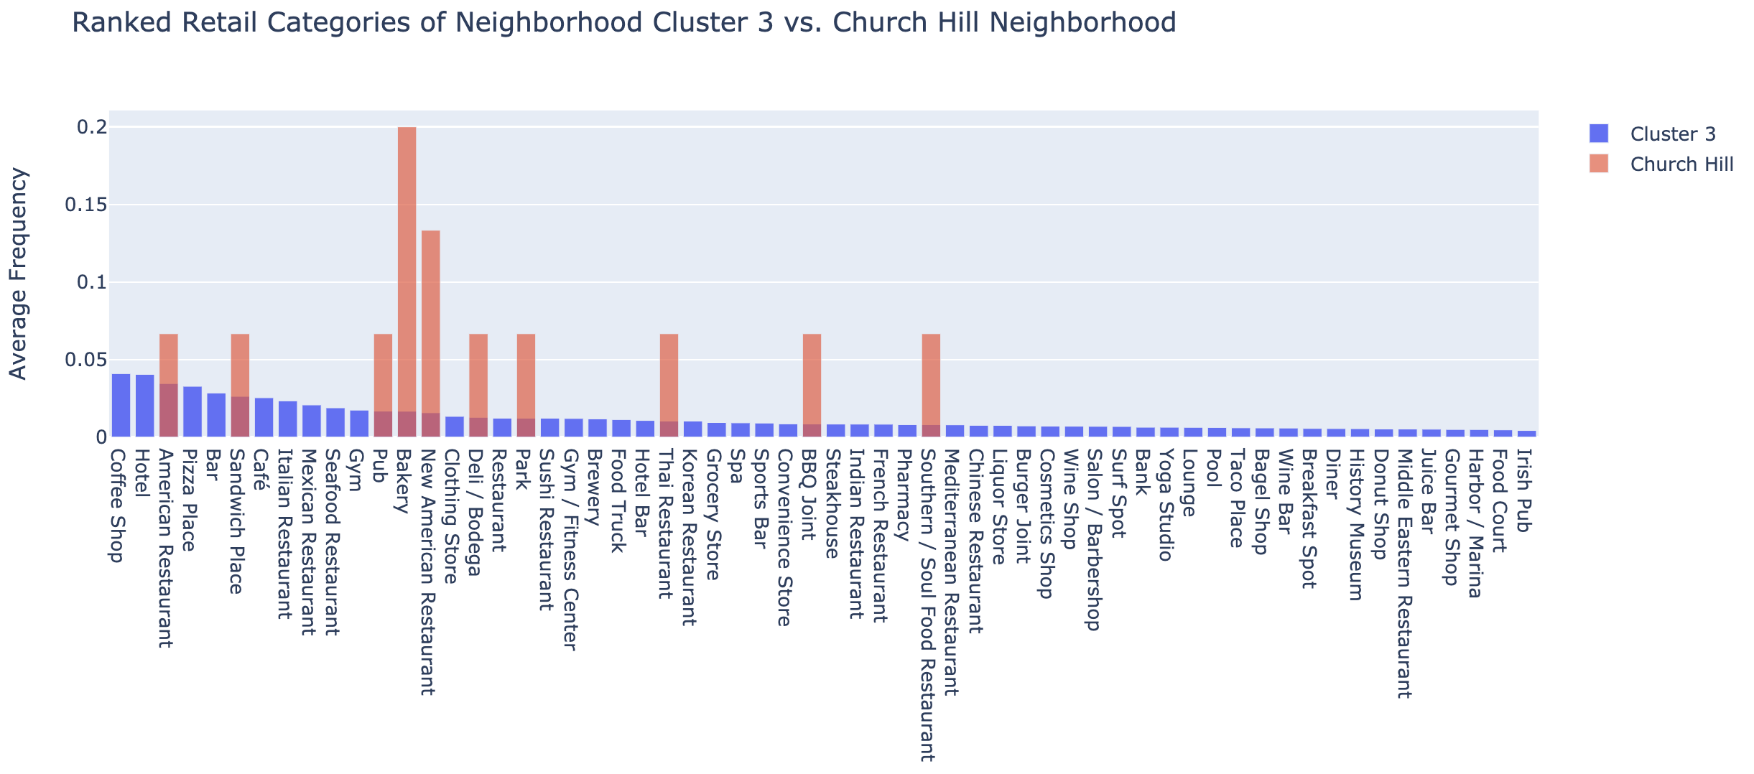
Analysis- Church Hill Compared to its Cluster

Slide 19
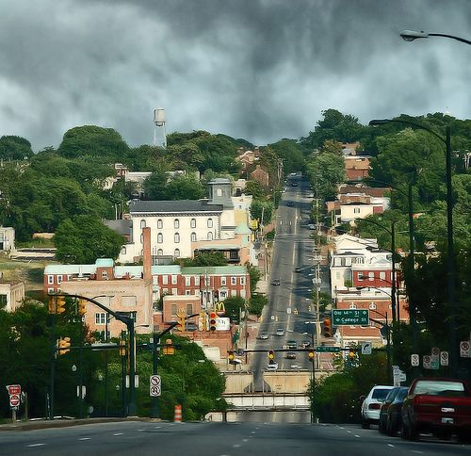
Conclusion - Results for Church Hill
Coffee shop
Hotel
Pizza place
Bar
Cafe
Italian Restaurant
Seafood Restaurant
Gym
Clothing store
Sushi restaurant

